Slide 1
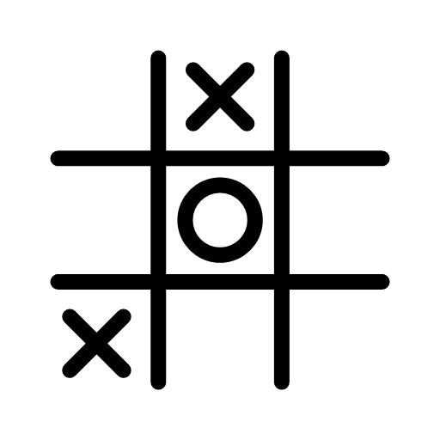
Tic-tac-toe by q-learning
Khandker Sadia Rahman
Department of Computer Science

Slide 2
OVERVIEW
Problem statement
Tic Tac Toe model
Demo
Q learning
Updates

Slide 3
PROBLEM STATEMENT
x is the human player
o is the q learned player
Consists of two players: x and o
Model a program using Q learning so it learns to play tic-tac-toe
Goal is to train the q learned player so it can compete with the human player

Slide 4
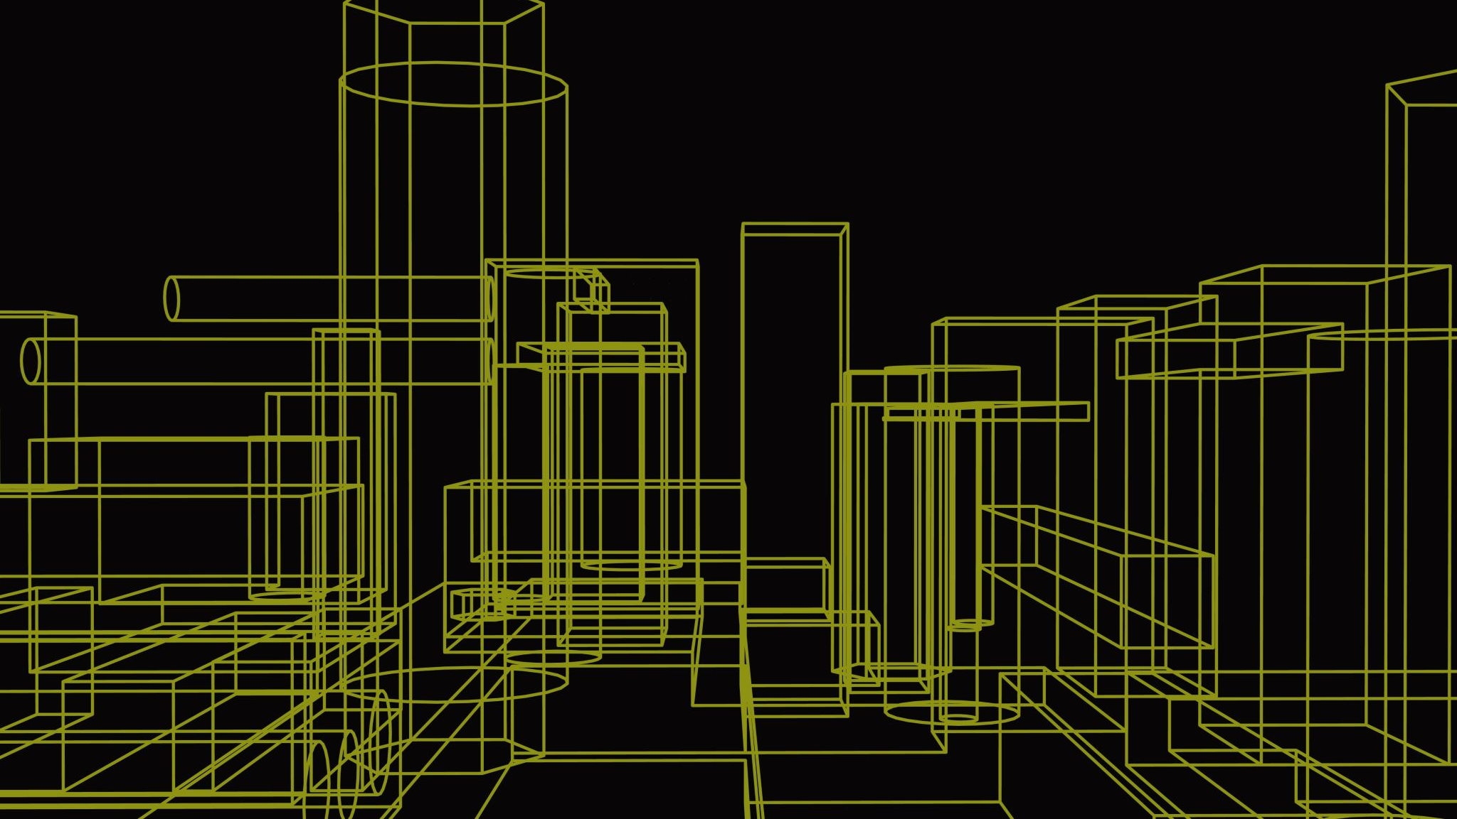
TIC TAC TOE

Slide 5

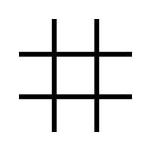

Components Of TIC TAC TOE Model
Environment: $3×3$ board
1
2
3
4
5
6
7
8
9

Slide 6


Components Of TIC TAC TOE Model
State of the board after every move
1
2
3
4
5
6
7
8
9
mark of the current player
(X or O)
9 positions of the board
1
2
3
4
5
6
7
8
9
1
2
3
4
5
6
7
8
9
9
0
9
9
1
0
9
9
9
X
1
9
9
9
0
1
9
9
9
O

Slide 7
Components Of TIC TAC TOE Model
Action: Player placing mark at any available position of the board
Available moves
1: (0,0)
3: (0,2)
4: (1,0)
6: (1,2)
7: (2,0)
8: (2,1)
9: (2,2)
1
2
3
4
5
6
7
8
9
9
0
9
9
1
0
9
9
9
X

Slide 8
Components Of TIC TAC TOE Model
Reward after every game
If X win, reward = 1
If draw, reward = 0.5
If O wins, reward = -1

Slide 9
Q learning algorithm
Pessimistic initialization:
Optimistic initialization:
Initializes with 1 and assumes every move will lead to a win
Updated initialization:
Initializes with $0.5+r$, where $r$ is a random number between 0 to 1, to avoid extreme conditions
Initializes with 0.5+𝑟, where 𝑟 is a random number between 0 to 1, to avoid extreme conditions
Initializes with 0 and assumes every move will lead to a loss
Initialize Q-table
Choose an action
Perform an action
Until the Q values converges
Measure the reward
Update Q-table

Slide 10
UPDATES
Greedy Epsilon strategy
Epsilon decay

Slide 11
Epsilon Greedy Strategy
It allows the agent to choose some of its moves randomly
At each step, a random number ($n$) is generated between 0 and 1.
At each step, a random number (𝑛) is generated between 0 and 1.
If $n>ε$, the agent chooses its next step via exploitation i.e., chooses the action with the highest Q value
If 𝑛>𝜖, the agent chooses its next step via exploitation i.e., chooses the action with the highest Q value
Otherwise, the agent chooses action via exploration i.e., randomly chooses an action

Slide 12
Notation for epsilon decay
$N:$ total number of episodes (iteration or game)
𝑁: total number of episodes (iteration or game)
$n_{steps}$: episode at which the Q player is at that time
𝑛_𝑠𝑡𝑒𝑝𝑠: episode at which the Q player is at that time
$ε_{init}, ε_{end}$ are the initial and final epsilon respectively
𝜖_𝑖𝑛𝑖𝑡, 𝜖_𝑒𝑛𝑑 are the initial and final epsilon respectively
$ε_{init}=1$ for complete random move
$ε_{end}=0$ for complete greedy move
𝜖_𝑖𝑛𝑖𝑡=1 for complete random move
𝜖_𝑒𝑛𝑑=0 for complete greedy move

Slide 13
Epsilon decay
Greedy epsilon strategy causes the game to choose randomly even when the Q values are learnt.
Decay the value of epsilon over time linearly
Step 1: Determine at what stage of training the Q player is in
$$r=N−n_{steps}$$
Step 1: Determine at what stage of training the Q player is in
𝑟=𝑁−𝑛_𝑠𝑡𝑒𝑝𝑠
Step 2: Compute $ε=\left(ε_{init}−ε_{end}\right)r+ε_{end}$
Step 2: Compute 𝜖=(𝜖_𝑖𝑛𝑖𝑡−𝜖_𝑒𝑛𝑑 )𝑟+𝜖_𝑒𝑛𝑑
If $n>ε$, the agent chooses its next step via exploitation Otherwise, the agent chooses action via exploration
If 𝑛>𝜖, the agent chooses its next step via exploitation Otherwise, the agent chooses action via exploration

Slide 14
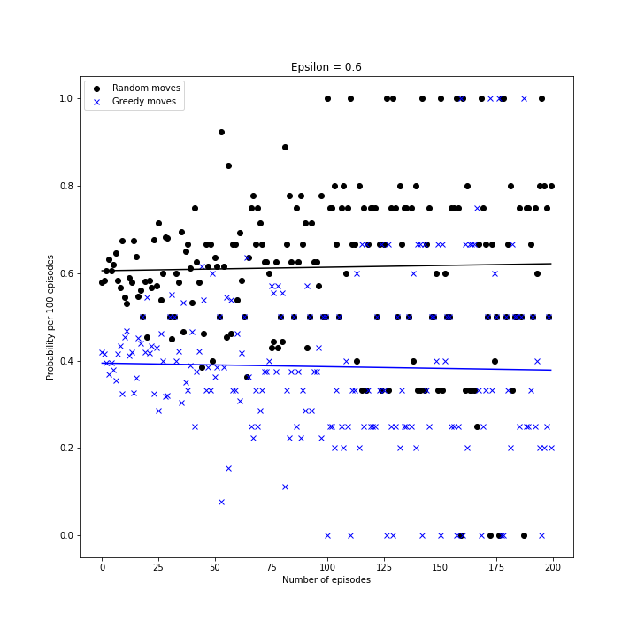
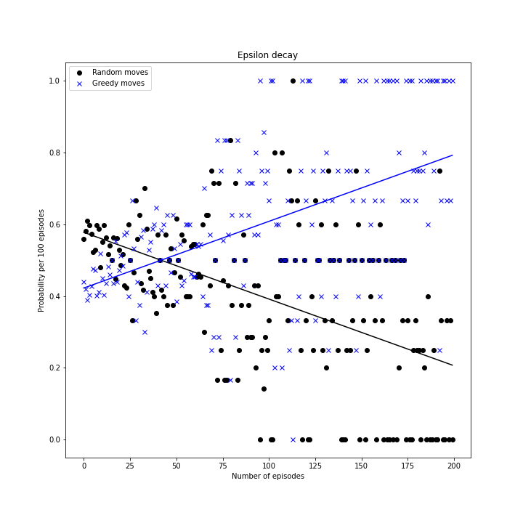
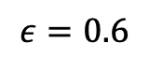
Greedy epsilon versus Epsilon decay
$$ε=0.6$$
Probability per 100 episodes
Number of episodes

Slide 15
UPDATES
Symmetry

Slide 16
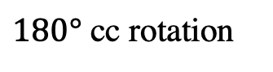
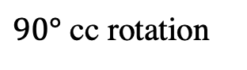
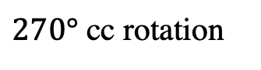
Symmetry
Actual board
$90°$ cc rotation
$180°$ cc rotation
$270°$ cc rotation
Mirror about x axis
Mirror about y axis

Slide 17
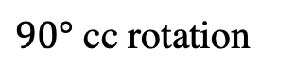
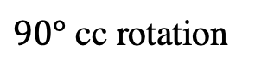
Change in coordinate
Prepared another tic tac toe board consisting of the coordinates of the actual board, MASK
Locating the coordinate of the actual board in the mask
Coordinate of the location = Corresponding coordinate in the rotated board
For every rotation or flip, the mask was rotated or mirrored as well.
(0,0)
(0,1)
(0,2)
(1,0)
(1,1)
(1,2)
(2,0)
(2,1)
(2,2)
Actual board
Mask
(0,2)
(1,2)
(2,2)
(0,1)
(1,1)
(2,1)
(0,0)
(1,0)
(2,0)
$90°$ cc rotation
$90°$ cc rotation

Slide 18
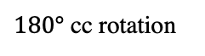
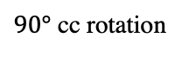
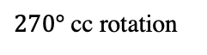
Improvement in convergence
Actual board
$90°$ cc rotation
$180°$ cc rotation
$270°$ cc rotation
For faster learning and convergence
Updated the Q value of the corresponding action of the symmetries as well
Mirror about x axis
Mirror about y axis

Slide 19
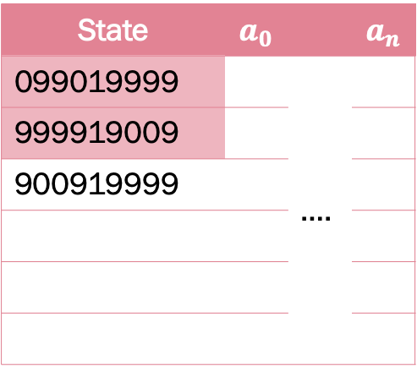
Q value update of the existing symmetries
Previously encountered
State | $$a_{0}$$ |  | $$a_{n}$$
099019999 |  | ….
999919009
900919999
Current state

Slide 20
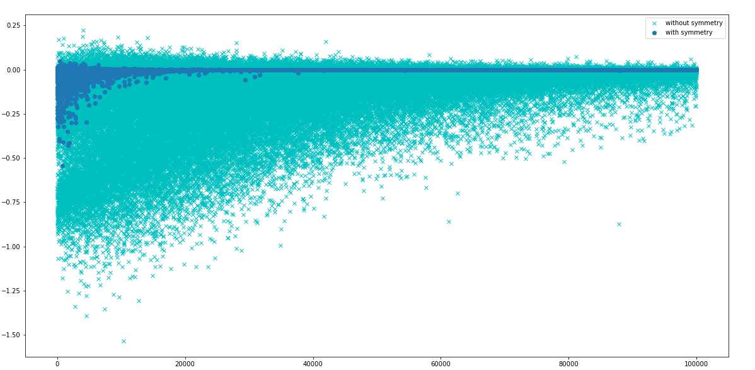
Convergence and Q value update of the existing symmetries
Total Change or Update per episode
Number of episodes
Notes:
Updating only the existing symmetries in the Q table

Slide 21
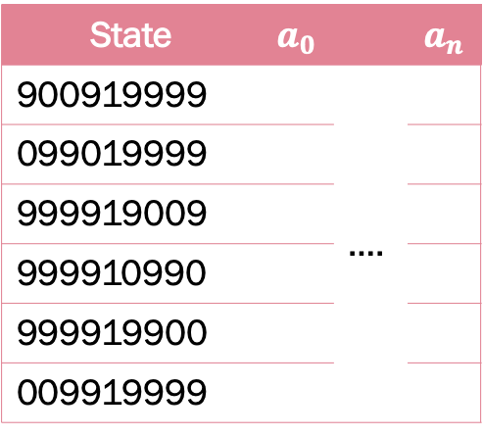
Q table append with all the symmetries
Symmetries
State | $$a_{0}$$ |  | $$a_{n}$$
900919999 |  | ….
099019999
999919009
999910990
999919900
009919999
Current state

Slide 22
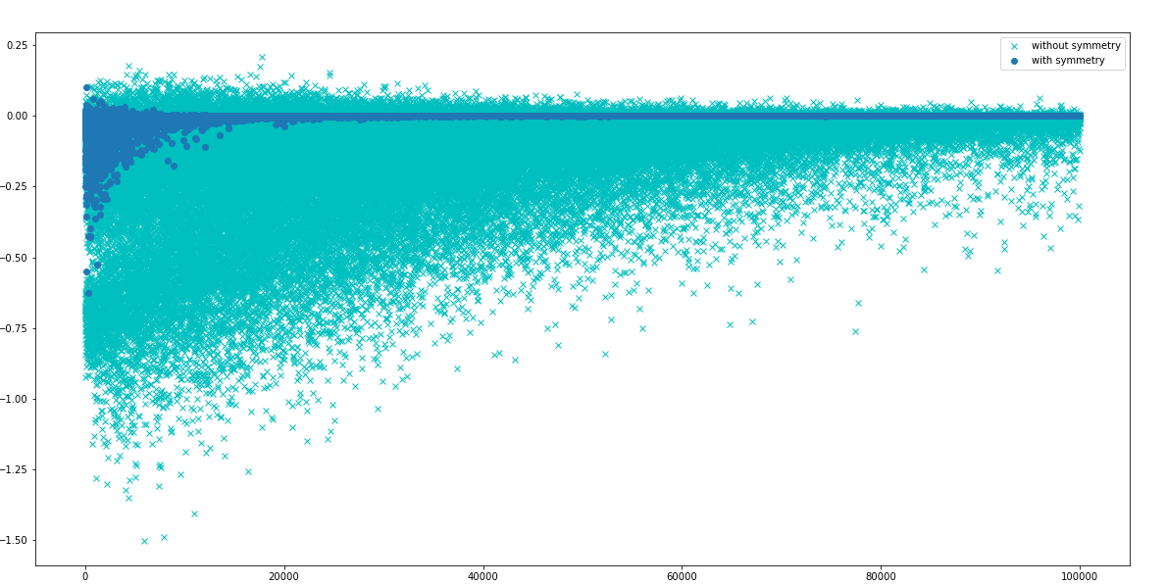
Convergence and Q table append with all the symmetries
Total Change or Update per episode
Number of episodes
Notes:
Updating only the existing symmetries in the Q table

Slide 23
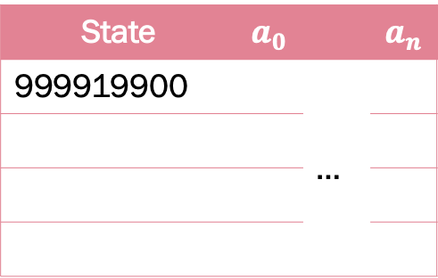
Reducing the number of states in the Q table
State | $$a_{0}$$ |  | $$a_{n}$$
999919900 |  | …

Slide 24
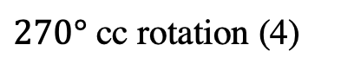
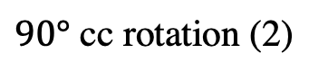
Challenge
Access current board
Access mask of $90°$ cc rotated board for its Q values
Access mask of 90° cc rotated board for its Q values
Access next board for update evaluation
Access mask of 27$0°$ cc rotated next board for its Q values
Access mask of 270° cc rotated next board for its Q values
Access the mask of $90°$ cc rotated board to update its Q value
Access the mask of 90° cc rotated board to update its Q value
Current board (1)
Next board (3)
Challenging to keep track of the current board and
$90°$ cc rotation (2)
$270°$ cc rotation (4)
$$Q\left(s,a\right)=\left(1−α\right)Q\left(s,a\right)+α(R\left(s,a,s^{′}\right)+γ\max_{π} Q(s′,a′))$$

Slide 25
Performance

Slide 26
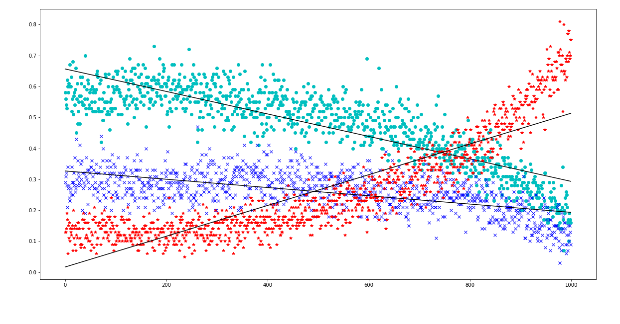
Performance: Q player versus Q player
Probability per 100 episodes
Q player X
Q player O
Number of episodes
Draw

Slide 27
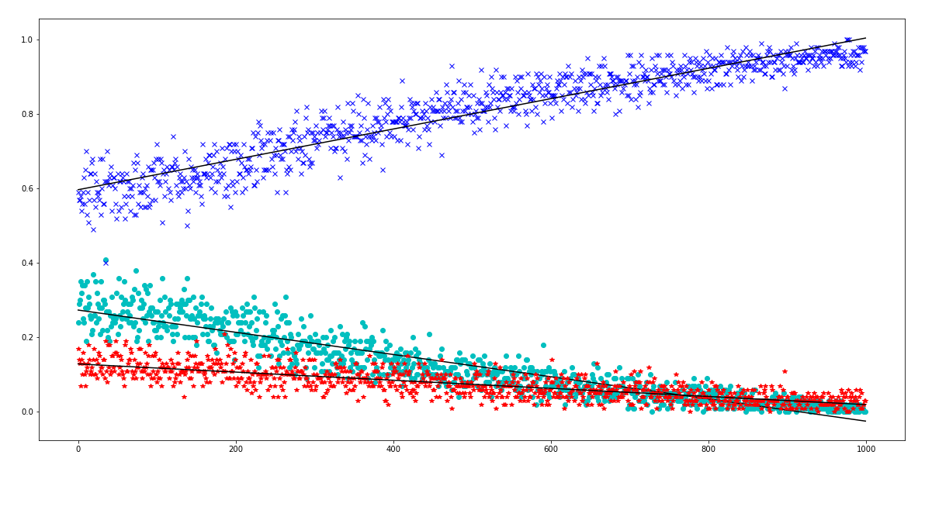
Performance: Q player versus Random player
Probability per 100 episodes
Q player X
Random player O
Number of episodes
Draw

Slide 28
Demonstration

Slide 29
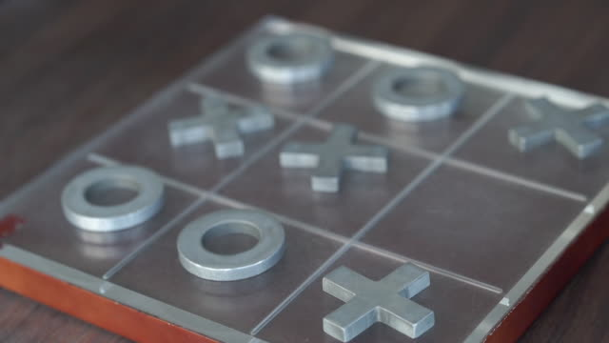
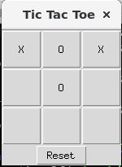
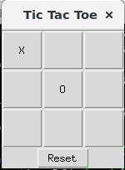
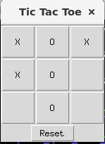
Expected outcome
Fully functional tic-tac-toe game

Slide 30
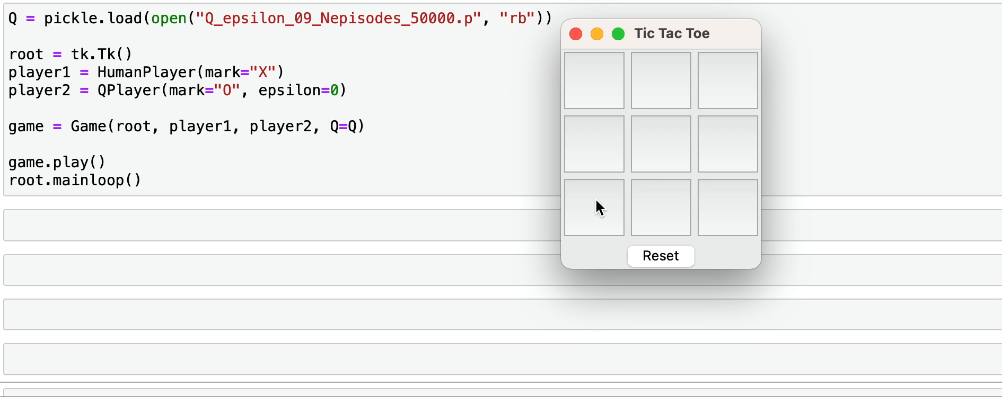
Demo at 50000

Slide 31
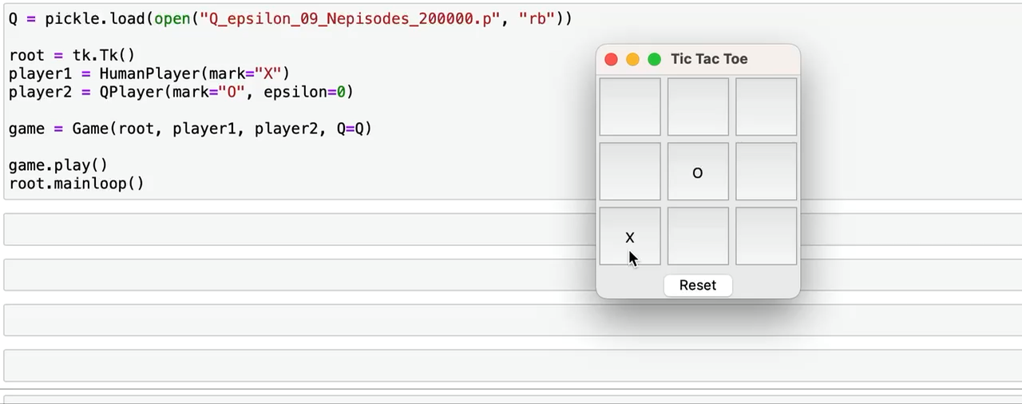
Demo at 200000

Slide 32
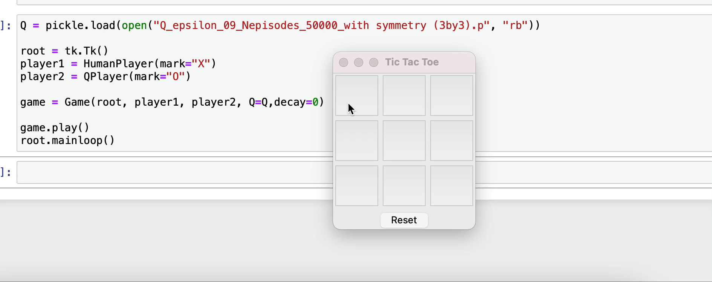
Demo at 50000 (including symmetry)

Slide 33
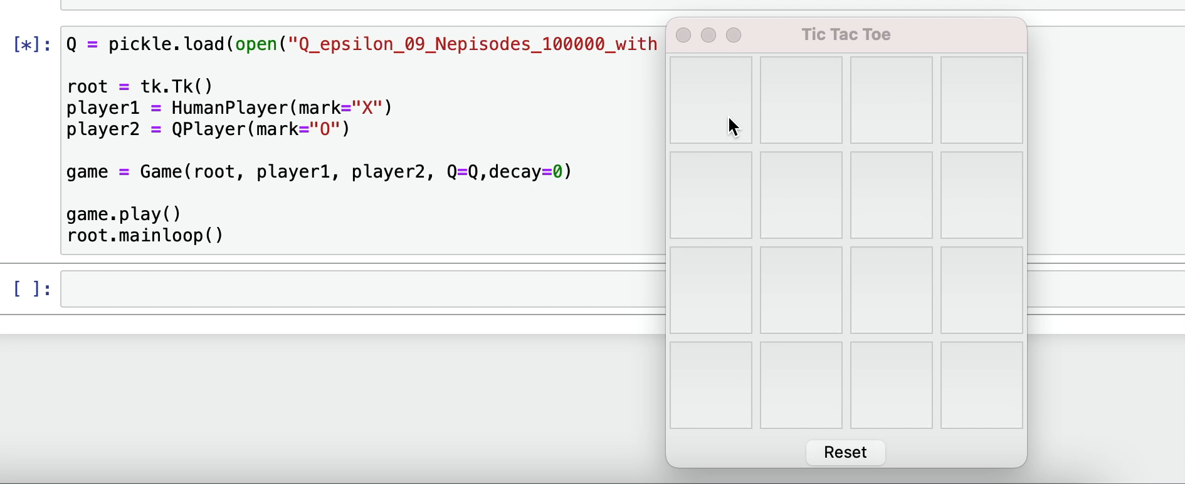
Demo for 4 by 4 tic tac toe

Slide 34

TAKE-AWAY
Debugging an existing code
Conceptual understanding
Q learning
Epsilon decay
Effect of symmetry on Q learning
Coding Skills
Upgrading it as per our need

Slide 35

Thank you

Slide 36

Appendix

Slide 37
References
https://medium.com/@carsten.friedrich/part-3-tabular-q-learning-a-tic-tac-toe-player-that-gets-better-and-better-fa4da4b0892a
https://towardsdatascience.com/math-of-q-learning-python-code-5dcbdc49b6f6
https://towardsdatascience.com/math-behind-reinforcement-learning-the-easy-way-1b7ed0c030f4

Slide 38
References
https://www.pico.net/kb/what-algorithm-for-a-tic-tac-toe-game-can-i-use-to-determine-the-best-move-for-the-ai/
https://www.neverstopbuilding.com/blog/minimax
https://web.archive.org/web/20200507202433id_/https://www.annualreviews.org/doi/pdf/10.1146/annurev-statistics-031219-041220
https://nestedsoftware.com/2019/12/27/tic-tac-toe-with-a-neural-network-1fjn.206436.html

